Slide 1

Indian Premier Leagues (IPL) Data Analysis
By Khushi Kansara

Slide 2
Goals:
Analyzing the Indian Premier League (IPL) data-set to :-
To Derive valuable insights for teams, coaches and cricket enthusiasts.
To present uncover trends, patterns and performance metrics from IPL data-set.
Upcoming slide presents :
IPL Match Analysis
Player Performance Analysis
Batting Line-up
Bowling Line-up
Team Performance Analysis
Lastly the procedure of Analysing the IPL Data-set.

Slide 3
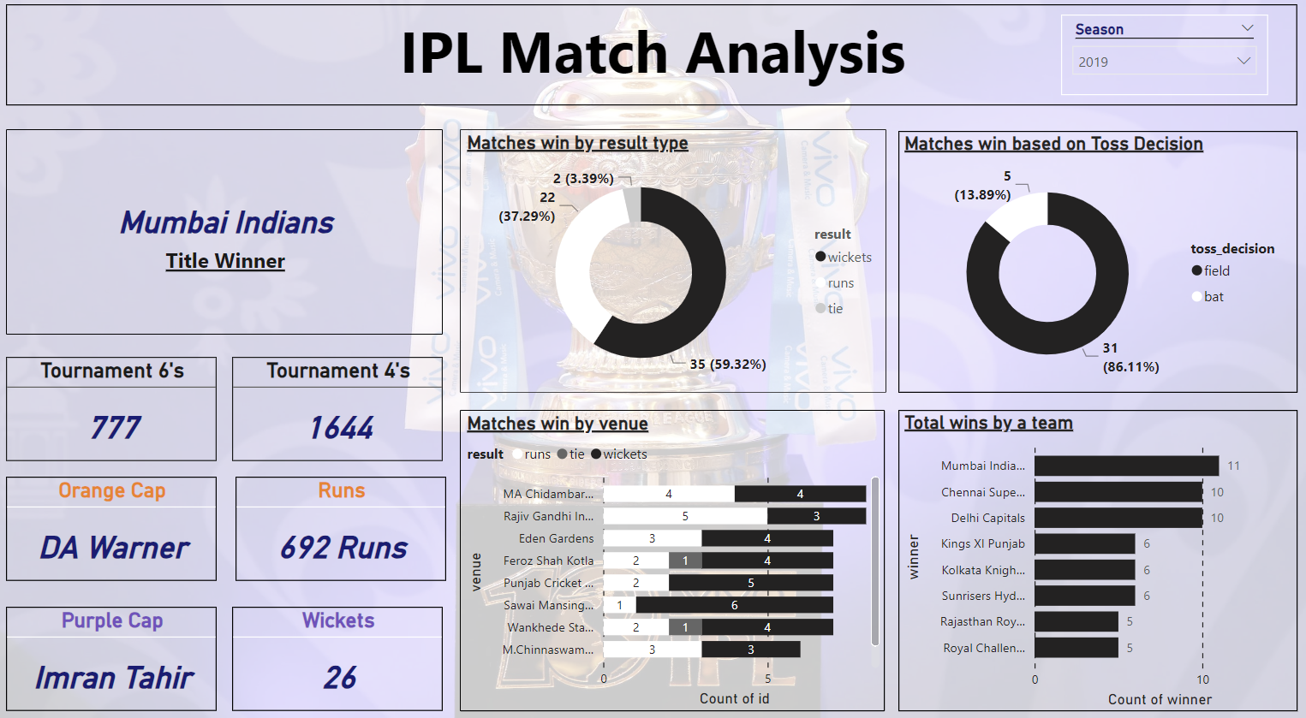

Slide 4
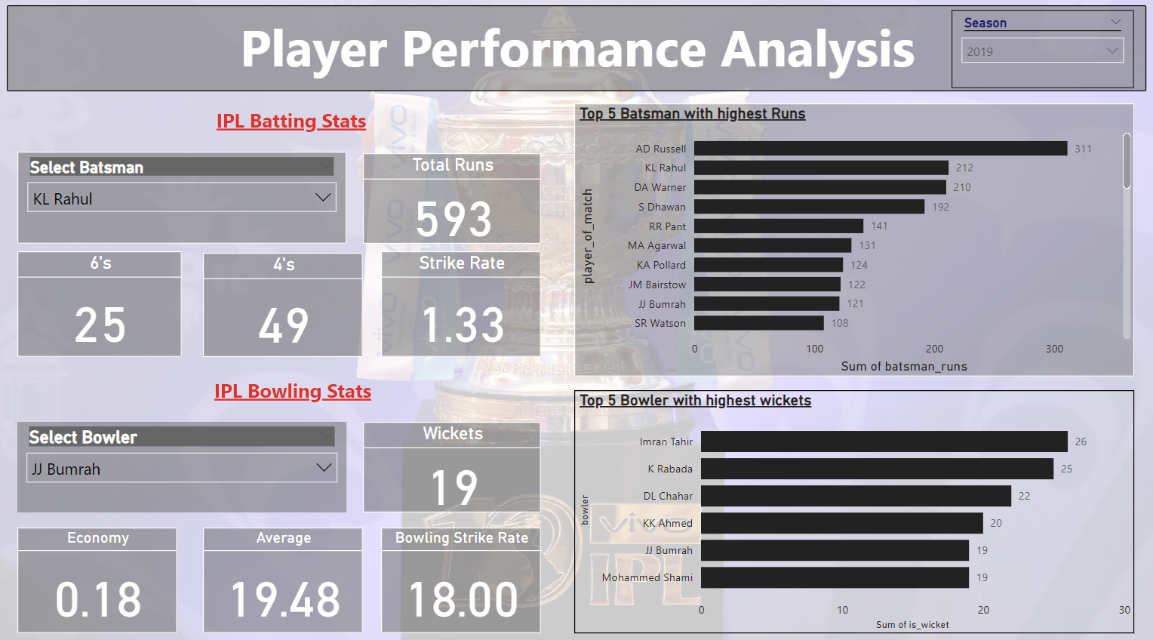

Slide 5
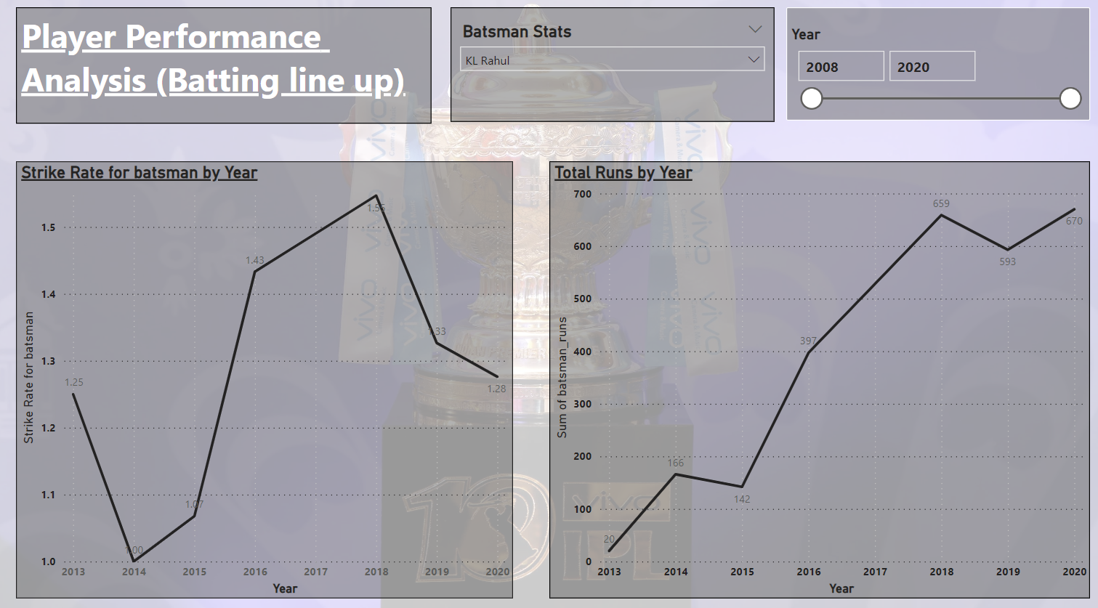

Slide 6
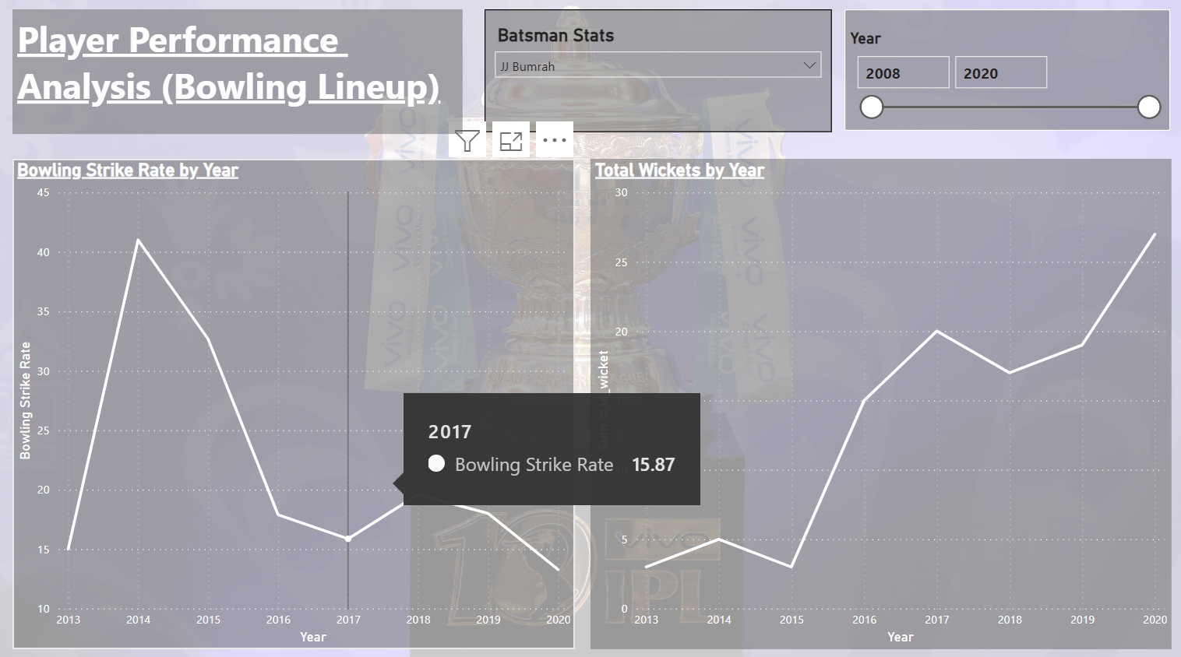

Slide 7
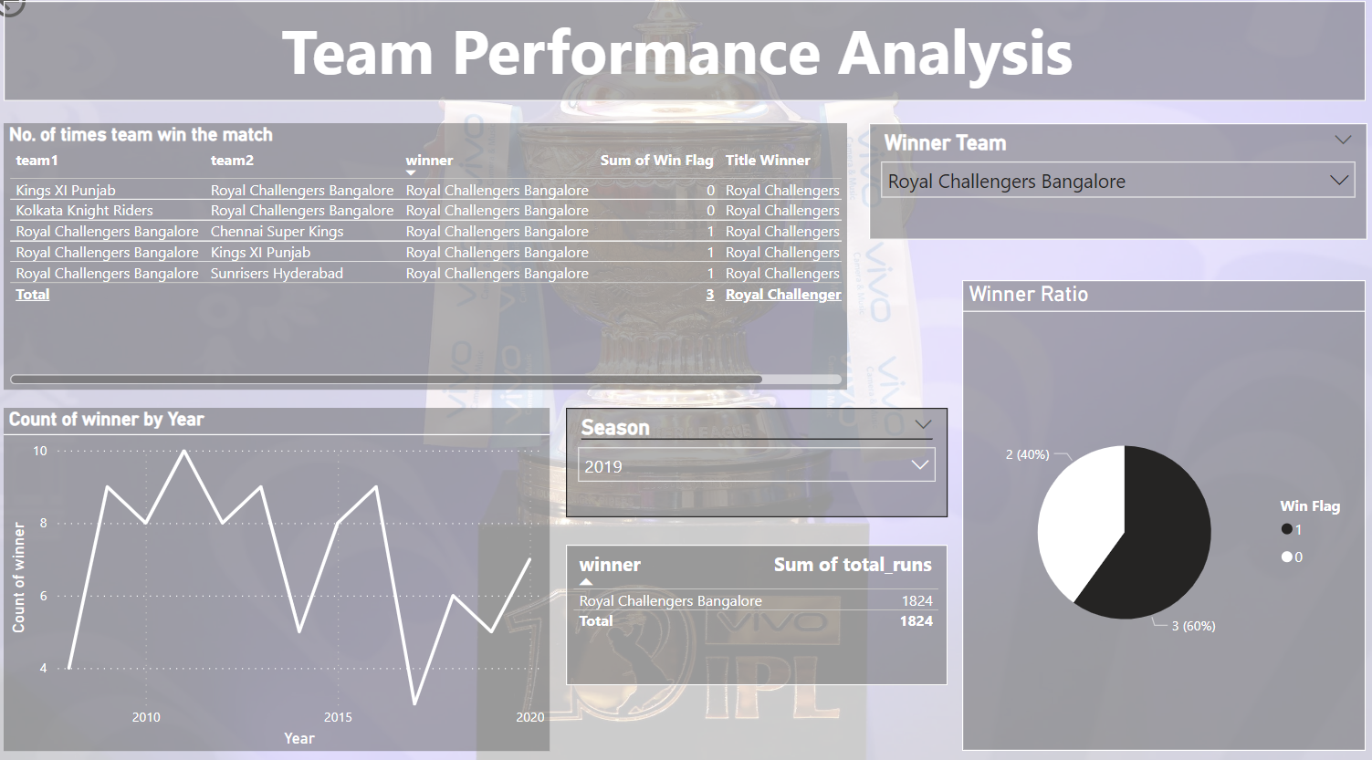

Slide 8
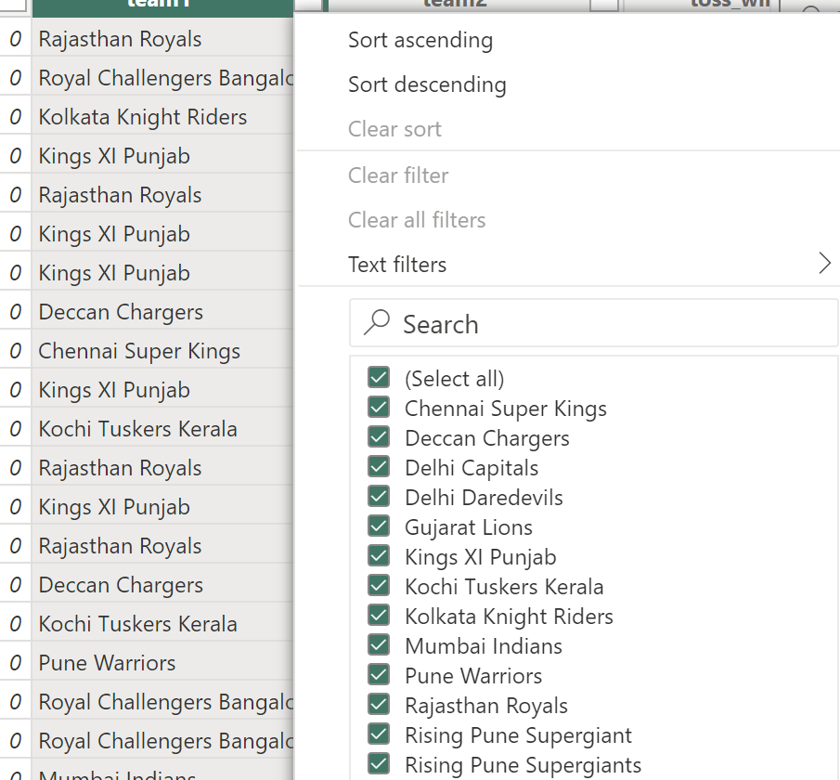
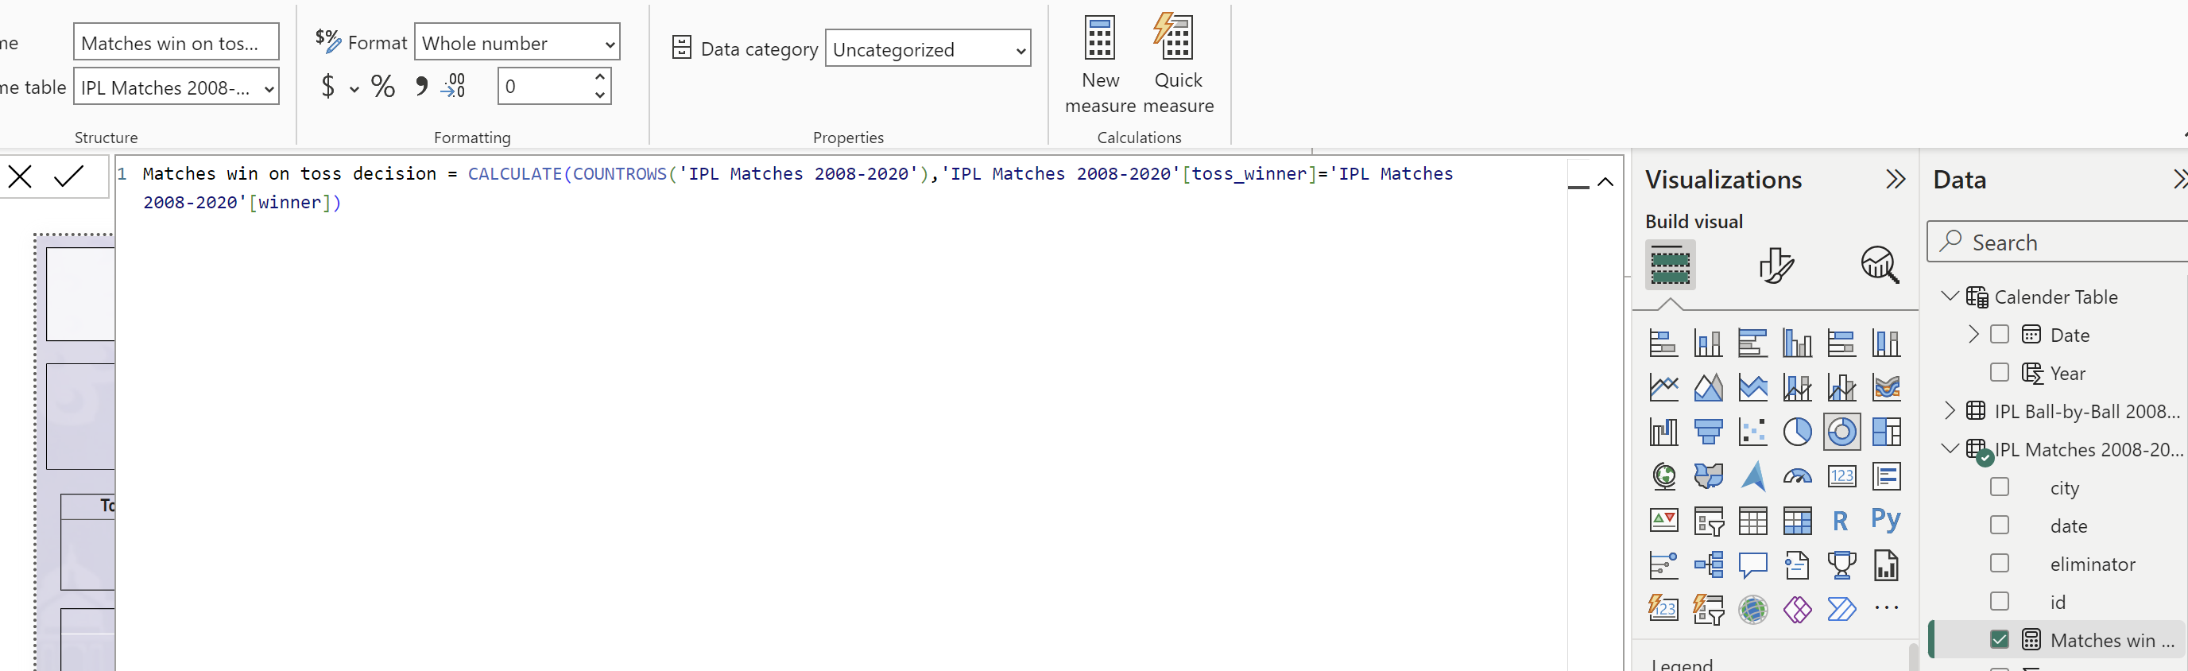
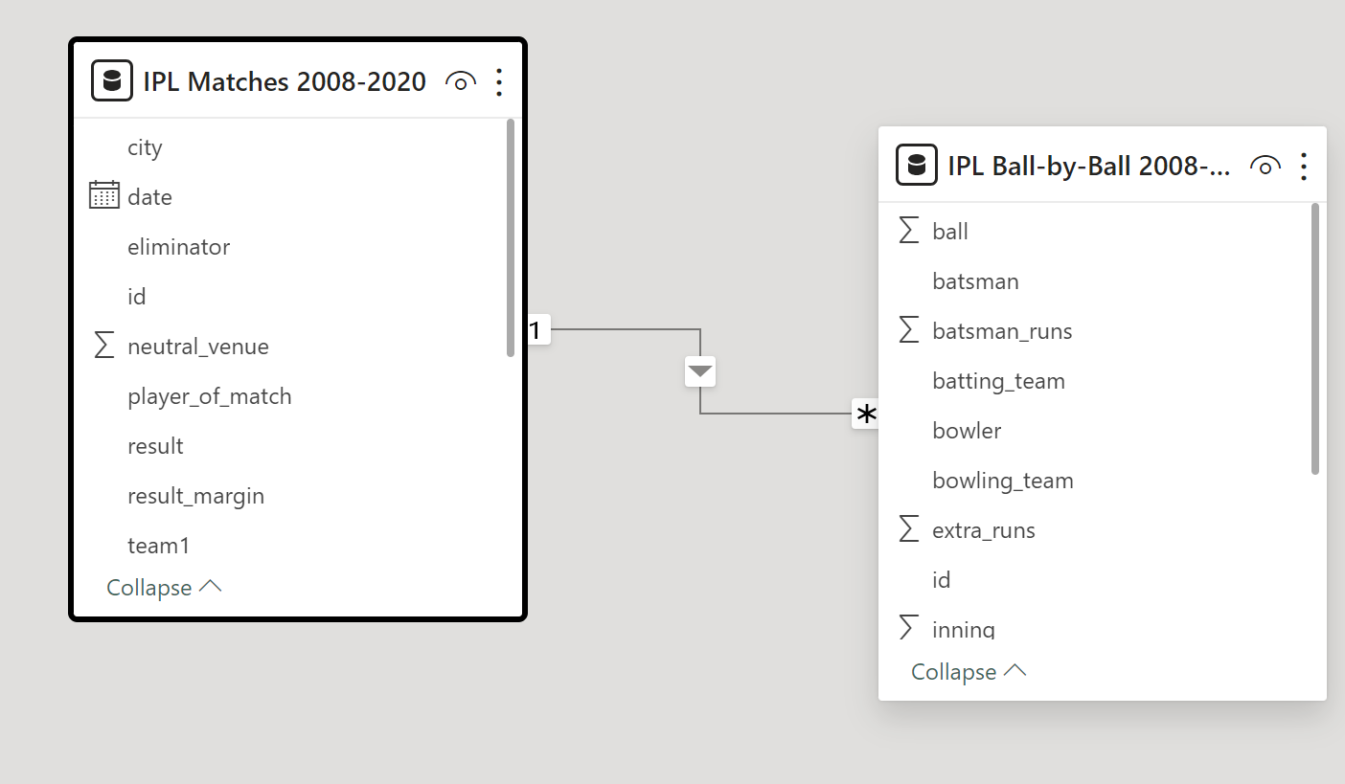
Process :
Adding Model Measure
Data Modeling
Data visualization
Insights & Recommendation
Data Modeling
Data visualization
Insights & Recommendation
Data cleaning
Data Understanding
Transform Data into Power Query
Transformation of Data to Power BI
Data Modelling
Data Understanding
Transform Data into Power Query
Transformation of Data to Power BI

Slide 9
THANK YOU

Slide 10
..\Documents\IPL Analysis.pbix

